Slide 1
Unit 4 Knowledge Representation
Lecture 2

Slide 2
Some Examples of FOL using quantifier:
1. All birds fly
In this question the predicate is "fly(bird)."And since there are all birds who fly so it will be represented as follows.
∀x bird(x) →fly(x).
2. Every man respect his parents
In this question, the predicate is "respect (x, y)," where x=man, and y= parent. Since there is every man so will use ∀, and it will be represented as follows:
∀x man(x) → respects (x, parent).

Slide 3
3.Some boys play cricket.
In this question, the predicate is "play (x, y)," where x= boys, and y= game. Since there are some boys so we will use ∃, and it will be represented as:
∃x boys(x) → play (x, cricket).
4. Not all students like both Mathematics and Science. In this question, the predicate is "like (x, y)," where x= student, and y= subject. Since there are not all students, so we will use ∀ with negation, so following representation
forthis:
¬∀ (x) [ student(x) → like (x, Mathematics) ∧ like(x, Science)]

Slide 4
More Examples on Predicate Logic:
Universal quantification: – Often associated with English words ―all, ―everyone, ―always, etc.
– Syntax:
∀ – E.g., Everyone at university is smart: ∀x At(x, university) ⇒ Smart(x) (we can also read this as ―if X is at university, then X is smart)
Typically, ⇒ is the main connective with ∀
Existential quantification:
• Often associated with English words ―someone, ―sometimes, etc.
– Syntax: ∃ – Example: Someone at university is smart: ∃x At(x, university) ∧ Smart(x)
Typically, ∧ is the main connective with ∃
Nesting and mixing quantifiers

Slide 5
# Convert the following to the language of predicate logic.
Every apple is either green or yellow
∀X(apple(X) ⇒ green(X)∨ yellow(X))
2. No apple is blue
∀X(apple(x) ⇒¬blue(X))
3. If an apple is green then its tasty
∀X((apple(X)∧ green(X)) ⇒tasty(X))
4. Every man likes a tasty apple
∀X∃Y(man(X)∧tasty Apple(Y) ⇒likes (X , Y))
Or
∀X∃Y((man(X)∧Apple(Y) ∧ tasty(Y))⇒likes (X ,Y))

Slide 6
5. Some people like garlic
∃X(person(X) ∧ likes (X, garlic))
6. All basketball players are tall
∀X (basketball Player(X) ⇒tall(X))
7. Every gardener likes the sun.
(∀x) gardener(x) => likes (x, Sun)
8. Not Every gardener likes the sun.
~((∀x) gardener(x) => likes (x, Sun))
9. John loves Mary
Loves (john, mary)

Slide 7
Resolution in Predicate Logic
Resolution is a rule of inference used in automated theorem proving and logic programming, particularly in predicate logic (first-order logic). It is a refutation-based proof technique, meaning that if the negation of a statement can be shown to lead to a contradiction, the statement is considered true.
Key Concepts:
Clause: A disjunction (OR) of literals. A literal is either a predicate or its negation.
Example: P(x)∨¬Q(x)

Slide 8
Unification: The process of making two terms identical by finding an appropriate substitution for variables. Unification is crucial for resolution because it allows us to match terms and eliminate variables.
Example: P(x) and P(y) can be unified by substituting x=y.

Slide 9
Steps of Resolution:
Convert to Conjunctive Normal Form (CNF): A formula in predicate logic is first converted into CNF (a conjunction of clauses, where each clause is a disjunction of literals).
Apply the Resolution Rule: Resolve two clauses by identifying complementary literals (a literal and its negation) and combining the remaining parts of the clauses.
Example: From P(x)∨Q(x)and ¬P(a)∨R(a), resolve the complementary literals P(x)and ¬P(a), yielding Q(a)∨R(a).
Repeat the Process: Continue applying resolution on the resulting clauses until a contradiction (empty clause) is found, which means the original set of statements is unsatisfiable.

Slide 10
Example:
Let’s consider the following premises:
∀x (P(x)→Q(x)) (If P(x) holds, then Q(x)must hold)
P(a)(For some constant a, P(a)is true) We want to prove that Q(a) holds.
Steps:
Convert to CNF:
∀x (P(x)→Q(x)) becomes ¬P(x)∨Q(x)
P(a) remains as is.
Resolution:
Resolve ¬P(a)∨Q(a) and P(a), which gives Q(a).
Thus, we have shown that Q(a) follows from the premises.

Slide 11
Resolution Numerical
If it is sunny and warm day you will enjoy
If it is raining you will get wet.
If it is a warm day
It is raining
It is sunny
Goal : you will enjoy

Slide 12
Resolution steps
Convert facts into FOL
Convert FOL into CNF
Negate the statement to be proved
Draw resolution graph

Slide 13
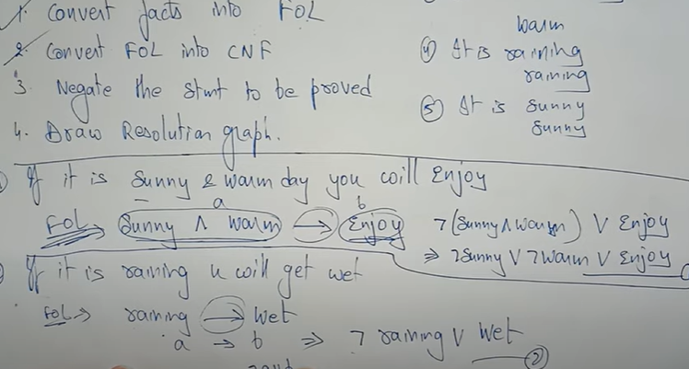

Slide 14
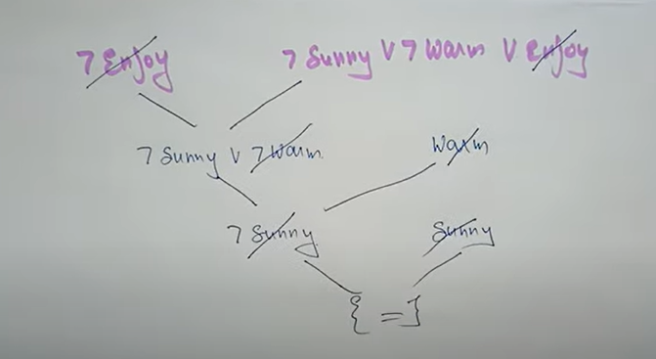

Slide 15
Reasoning Under Uncertainty
Reasoning under uncertainty is a key aspect of artificial intelligence, where conclusions need to be drawn even when there is incomplete or uncertain information. Several techniques have been developed to handle uncertainty:
Probabilistic Reasoning:
Probabilistic reasoning involves using probability theory to reason about uncertain events. It allows reasoning about the likelihood of events based on available evidence.
Bayes' Theorem: A foundational tool in probabilistic reasoning, it describes how to update the probability of a hypothesis based on new evidence.

Slide 16
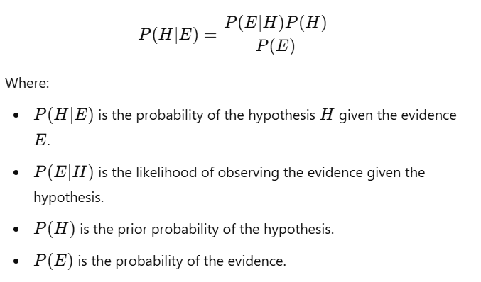

Slide 17
Bayesian Networks:
A Bayesian Network (or belief network) is a graphical model that represents a set of variables and their probabilistic dependencies. Each node in the graph represents a variable, and the edges represent conditional dependencies between variables.
Nodes represent random variables.
Edges represent dependencies (causal relationships).
Conditional Probability Tables (CPTs) are used to specify the likelihood of each variable given its parents in the network.
Example: Consider a simple Bayesian Network with two nodes, A (weather) and B (traffic):
A influences B, meaning if the weather is bad, traffic is more likely to be heavy.
We can calculate the probability of heavy traffic given the weather conditions using Bayes' theorem.

Slide 18
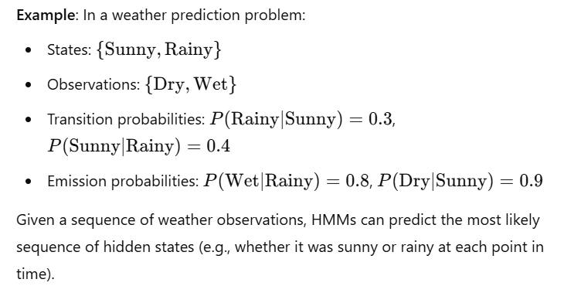

Slide 19
Semantic network
A semantic net (or semantic network) is a knowledge representation technique used for propositional information.
So, it is also called a propositional net. Semantic nets convey meaning.
They are two dimensional representations of knowledge. Mathematically a semantic net can be defined as a labelled directed graph.
Semantic nets consist of nodes, links (edges) and link labels.
In the semantic network diagram, nodes appear as circles or ellipses or rectangles to represent objects such as physical objects, concepts or situations. Links appear as arrows to express the relationships between objects, and link labels specify particular relations.
Relationships provide the basic structure for organizing knowledge.
The objects and relations involved need not be so concrete. As nodes are associated with other nodes semantic nets are also referred to as associative nets.

Slide 20
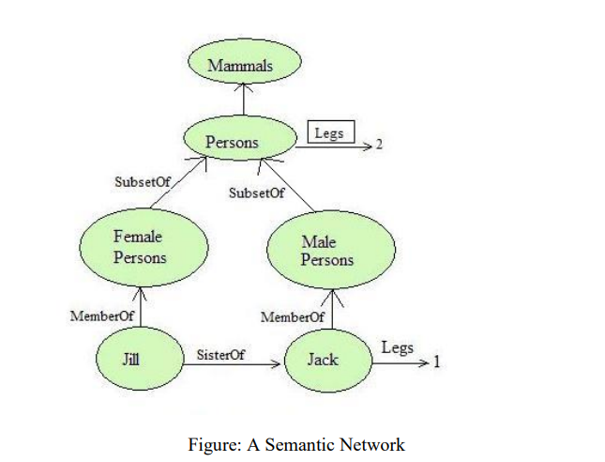

Slide 21
In the above figure all the objects are within ovals and connected using labelled arcs.
Note that there is a link between Jill and Female Persons with label MemberOf.
Simlarly there is a MemberOf link between Jack and Male Persons and SisterOf link between Jill and Jack.
The MemberOf link between Jill and Female Persons indicates that Jill belongs to the category of female persons.

